Slide 1
Ecommerce Demo

Slide 2
Functional requirement
Login
Registration
Administrator Site
Search or choose products
Product Catalog
Sales
Stock
Price
Apply filter
Add to cart
Payment
Order Confirmation

Slide 3
Non-Functional requirements
Security
Authentication & Authorization
Data Encryption
Input Validation
Dependency Scanning
Secure by Default
Disaster Recovery
Data Backup
Recovery Point Objective (RPO)
Recovery Time Objective (RTO)
Regular Testing
High Availability
Uptime
Redundancy
Load Balancing
Health Checks
Performance
Page Load Time
API Response Time
Scalability
Concurrency
Caching
DAR - NAGP.docx

Slide 4
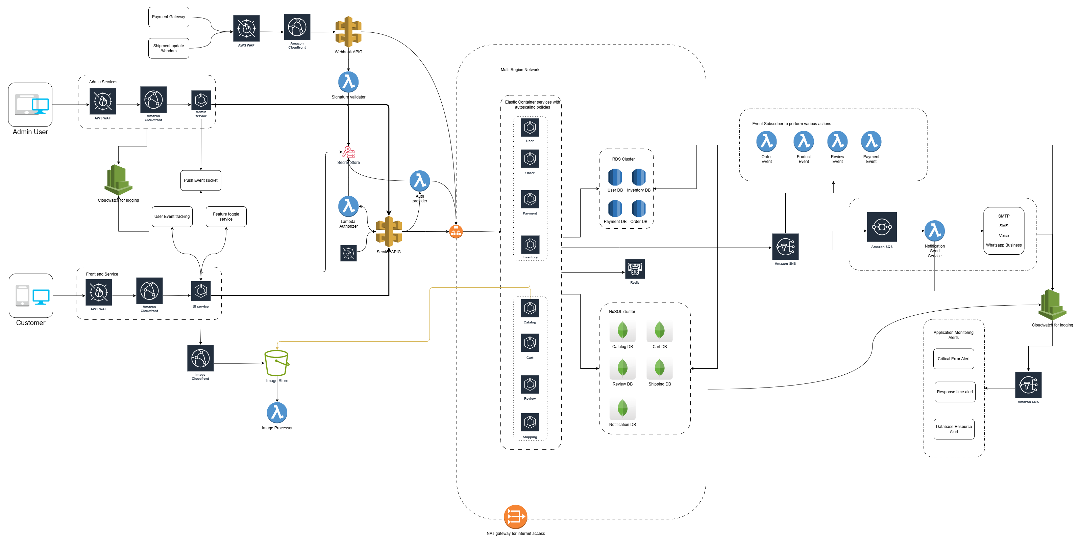
System Architecture

Slide 5
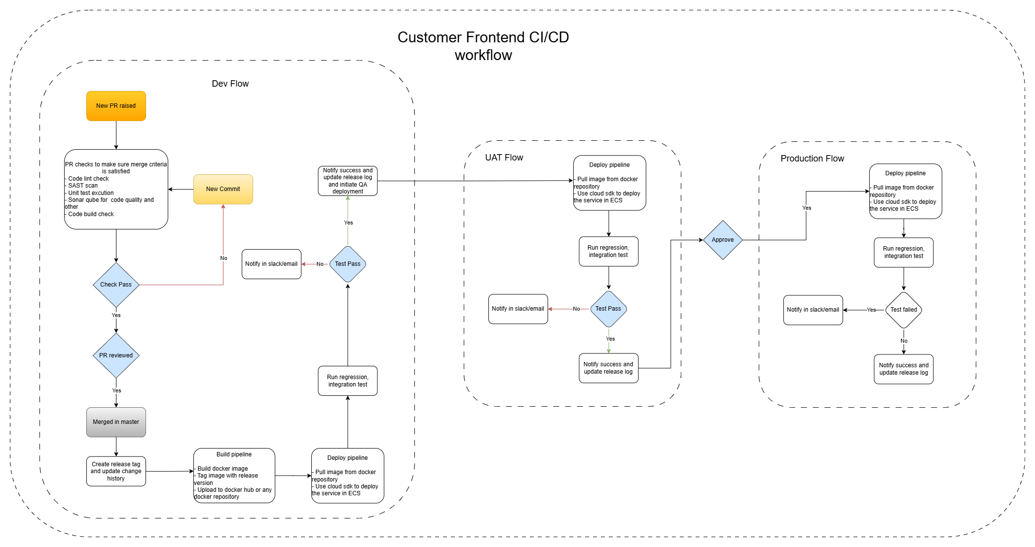

Slide 6
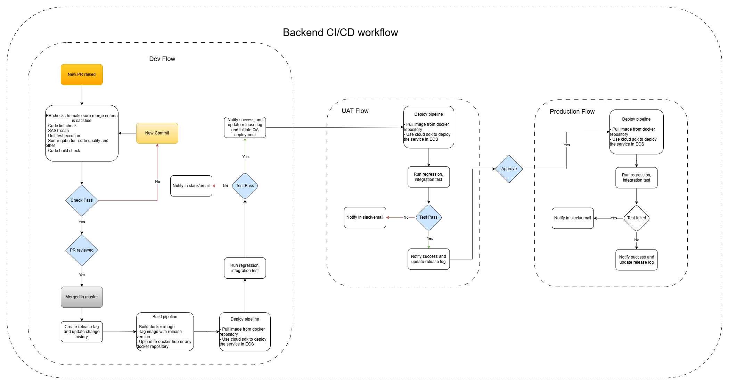

Slide 7
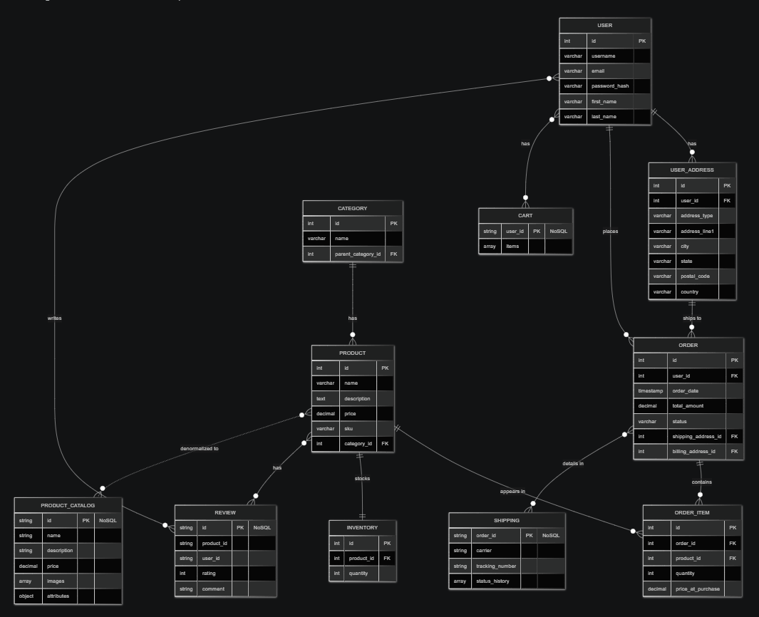
DB Design Diagram

Slide 8
Demo

